Slide 1

Psychopharmacology: Drugs, the Brain, and Behavior
by Meyer, Farrar, Biezonski, Yates

Slide 2
Chapter 12
Psychomotor Stimulants: Cocaine, Amphetamine, and Related Drugs
12.1 Background, Basic Pharmacology, and Mechanisms of Action of Cocaine
12.2 Acute Behavioral and Physiological Effects of Cocaine
12.3 Cocaine Use and the Effects of Chronic Cocaine Exposure
12.4 Background, History, and Basic Pharmacology of the Amphetamines
12.5 Mechanisms of Action and Neurobehavioral Effects of Amphetamines
12.6 Methylphenidate and Modafinil
12.7 Synthetic Cathinones

Slide 3
Chapter 12
Learning Objectives (1 of 7)
12.1.1 Describe the history of coca and cocaine use beginning in South America and later reaching the Western world.
12.1.2 Discuss the basic pharmacology of cocaine, including its different chemical forms and routes of administration.
12.1.3 Describe cocaine’s mechanisms of action, particularly with respect to relevant neurotransmitter systems.

Slide 4
Chapter 12
Learning Objectives (2 of 7)
12.2.1 Describe (a) the behavioral and psychological effects of differing doses of cocaine, and (b) cocaine’s physiological effects that are mediated by the sympathetic nervous system.
12.2.2 Discuss the evidence supporting a key role for DA in the behavioral effects of cocaine and other psychostimulants, including both preclinical animal studies and brain imaging studies in humans.
12.2.3 Discuss the involvement of DA receptor subtypes in mediating the functional effects of psychostimulants.

Slide 5
Chapter 12
Learning Objectives (3 of 7)
12.3.1 Describe the identified patterns of cocaine use, the characteristics of cocaine binges, and the development of cocaine use disorder.
12.3.2 Discuss the neurobiological and behavioral changes caused by chronic cocaine exposure.
12.3.3 List the major health consequences that can occur as a result of repeated and/or high-dose cocaine use.
12.3.4 Describe the various therapeutic approaches available to treat cocaine use disorder.

Slide 6
Chapter 12
Learning Objectives (4 of 7)
12.4.1 Discuss the history and uses (medical and recreational) of the family of psychostimulants that includes amphetamine, methamphetamine, cathinone, and ephedrine.
12.4.2 Describe the basic pharmacology of amphetamine and methamphetamine.

Slide 7
Chapter 12
Learning Objectives (5 of 7)
12.5.1 Explain the mechanisms of action of amphetamines on the dopaminergic system.
12.5.2 Contrast the therapeutic uses of amphetamines with their illicit use.
12.5.3 Discuss the features of methamphetamine misuse, including (a) dependence and withdrawal and (b) impaired cognitive function.
12.5.4 Describe evidence showing that high-dose methamphetamine use causes psychotic reactions, neurotoxicity, and other health problems.

Slide 8
Chapter 12
Learning Objectives (6 of 7)
12.6.1 Discuss the pharmacology of methylphenidate.
12.6.2 Describe the features of ADHD, including symptoms, proposed dysfunction of the PFC catecholamine symptoms, and the mechanisms of action of drugs (including psychostimulants) used to treat this disorder.
12.6.3 Discuss the pharmacology of modafinil and its therapeutic use in the treatment of narcolepsy.

Slide 9
Chapter 12
Learning Objectives (7 of 7)
12.7.1 Name the four synthetic cathinones that have been studied most extensively, and describe their introduction as “street drugs.”
12.7.2 Discuss the basic pharmacology of synthetic cathinones, including routes of administration, subjective effects, and mechanisms of action.
12.7.3 Describe the evidence for potential neurotoxic effects of synthetic cathinones.

Slide 10
Background, Pharmacology, and
Mechanisms of Action of Cocaine (1 of 5)
Background
Cocaine: alkaloid in leaves of the shrub Erythroxylon coca native to South America
The practice of chewing coca leaves began 5000 years ago.
Pure cocaine isolated in 1850s; there were many famous users, including Freud
Cocaine was used in many medications—Coca Cola was introduced in 1886
Cocaine abuse became widespread; 1914 Harrison act prohibited cocaine in OTC medicines
Cocaine use by snorting or IV injection increased in the 1970s; more recently, “crack” cocaine became popular
Notes:
Instructor Notes:

Slide 11
Background, Pharmacology, and
Mechanisms of Action of Cocaine (2 of 5)
Basic pharmacology
Cocaine is extracted from coca leaves, converted to a hydrochloride (HCl) salt and crystallized.
Cocaine HCl is water-soluble and thus can be taken orally, intranasally (snorting), or by IV injection; can not be smoked
Cocaine HCl can be transformed back into cocaine that can be smoked by two methods:
  Freebasing
  Crack
Notes:
Instructor Notes:
Two synthetic cocaine-like drugs have been synthesized; more potent than cocaine, but used only experimentally: WIN 35,428 (also known as CFT) & RTI-55 (also called β-CIT).
Freebasing: Dissolve in water, add an alkaline solution such as ammonia, extract the cocaine base with an organic solvent, typically ether. The term freebasing refers to smoking cocaine that was obtained in this manner.
Crack: Mix dissolved cocaine HCl with baking soda, heat the mixture, then dry it. Chunks of crack are heated and the vapor inhaled.

Slide 12
Background, Pharmacology, and
Mechanisms of Action of Cocaine (3 of 5)
Basic pharmacology
Extremely rapid absorption occurs with IV injection and smoking; slower with snorting and oral use.
Once absorbed, cocaine is rapidly broken down and excreted; the subjective high lasts about 30 minutes.
Metabolites such as benzoylecgonine can be detected in the urine for several days
Cocaine plus alcohol produce a unique metabolite called cocaethylene – has activity similar to cocaine
Notes:
Instructor Notes:

Slide 13
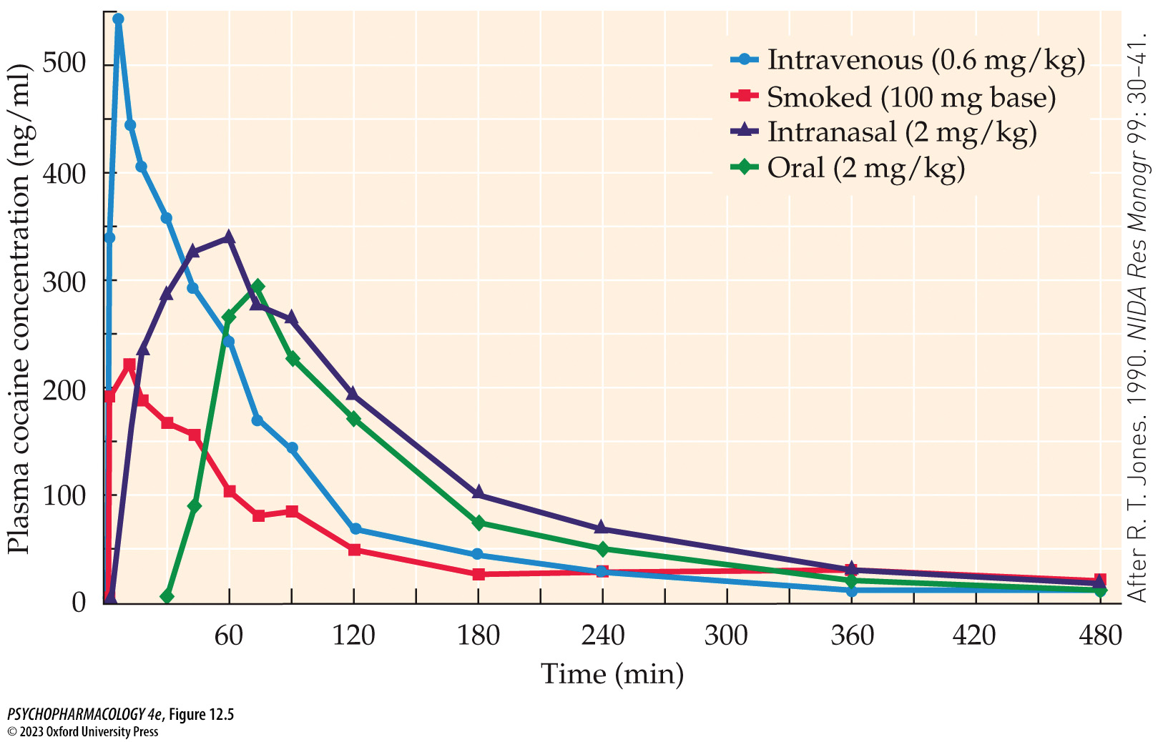
FIGURE 12.5 Time course of plasma cocaine concentrations following different routes of administration
Notes:
FIGURE 12.5 Time course of plasma cocaine concentrations following different routes of administration
Each curve shows the mean for 10 human participants. For cocaine freebase smoking, participants were allowed only one to three puffs of the vapor from 100 mg of drug heated in a flask. The peak plasma concentrations produced under these conditions probably underestimate the levels occurring from recreational use. (After R. T. Jones. 1990. NIDA Res Monogr 99: 30–41.)

Slide 14
Background, Pharmacology, and
Mechanisms of Action of Cocaine (4 of 5)
Mechanisms of action
Most of cocaine’s actions are due to its ability to block reuptake of DA, NE, and 5-HT by inhibiting their membrane transporters; increased synaptic concentrations of transmitters increases rate of transmission
Inhibition of DA reuptake is most important for cocaine’s behavioral effects and addictive potential
Inhibition of DA reuptake can occur very rapidly, as shown by microdialysis studies
Notes:
Instructor Notes:

Slide 15
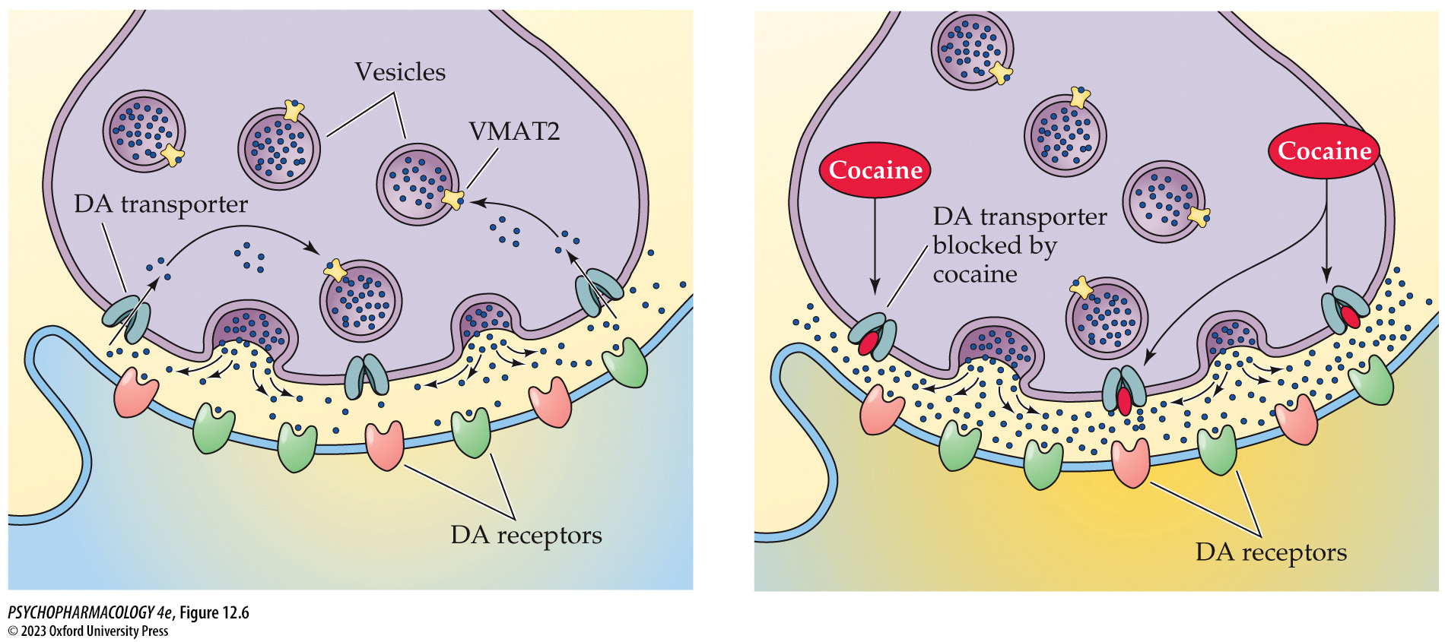
FIGURE 12.6 Mechanisms of cocaine action
Notes:
FIGURE 12.6 Mechanisms of cocaine action
Cocaine increases synaptic DA levels by binding to the plasma membrane DA transporter and blocking reuptake of the neurotransmitter. A similar process occurs at serotonergic and noradrenergic synapses because of cocaine’s inhibition of 5-HT and NE re­uptake. VMAT2, vesicular monoamine transporter 2.

Slide 16
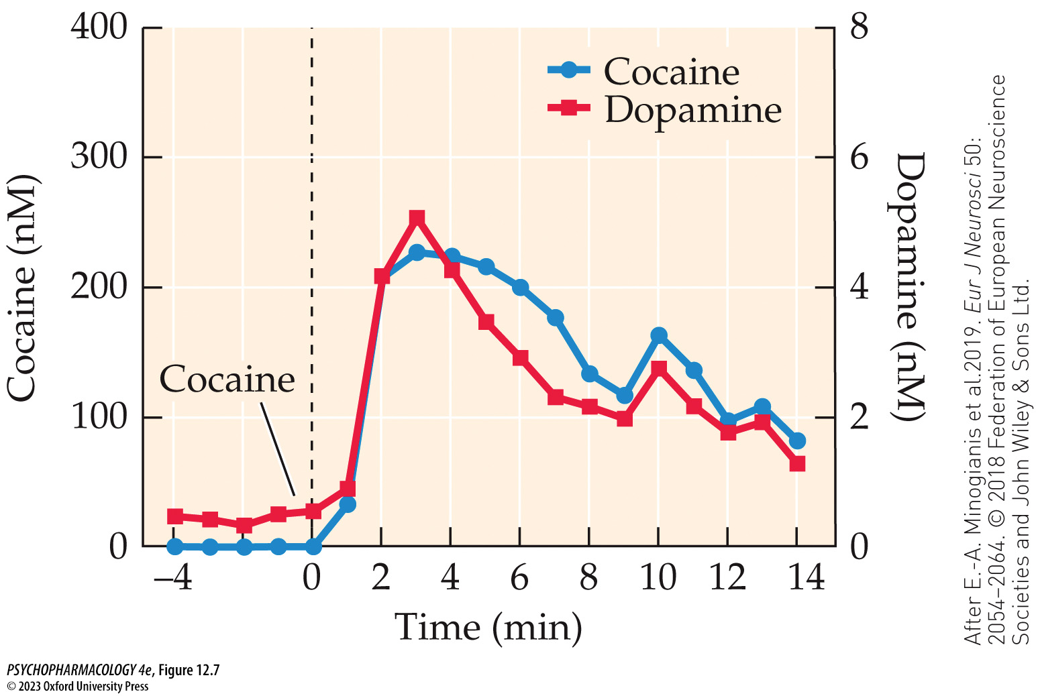
FIGURE 12.7 Time course of striatal cocaine and DA concentrations following rapid IV cocaine infusion
Notes:
FIGURE 12.7 Time course of striatal cocaine and DA concentrations following rapid IV cocaine infusion
Microdialysis probes aimed at the dorsal striatum collected samples for measurement of cocaine and DA concentrations at 2-minute intervals following a 5-second infusion of 2 mg/kg cocaine. The close relationship between these variables is consistent with cocaine causing rapid increases in extracellular DA in this brain region. Note that the DA concentrations measured in the extracellular fluid were much lower than the respective cocaine concentrations; however, because microdialysis assesses neurotransmitter overflow (i.e., transmitter molecules that have eluded uptake mechanisms), the synaptic DA levels were likely much greater than those shown here. (After E.-A. Minogianis et al. 2019. Eur J Neurosci 50: 2054–2064. © 2018 Federation of European Neuro­science Societies and John Wiley & Sons Ltd.)

Slide 17
Background, Pharmacology, and
Mechanisms of Action of Cocaine (5 of 5)
Mechanisms of action
Cocaine also increases frequency of transient DA release events; it inhibits NE uptake in the PFC, causing an α₁-adreno-ceptor–mediated stimulation of glutamatergic pyramidal neurons that project to the VTA.
Striatal cholinergic interneurons and ACh release are regulated by DA – they exert a blunting effect on cocaine-associated responses
Activation of serotonergic signaling specifically counteracts cocaine-related reward and reinforcement.
At higher concentrations, cocaine also blocks voltage-gated Na⁺ channels; leads to a local anesthetic effect.
Notes:
Instructor Notes:

Slide 18
Review of Learning Objectives (1 of 7)
12.1.1 Describe the history of coca and cocaine use beginning in South America and later reaching the Western world.
12.1.2 Discuss the basic pharmacology of cocaine, including its different chemical forms and routes of administration.
12.1.3 Describe cocaine’s mechanisms of action, particularly with respect to relevant neurotransmitter systems.

Slide 19
Acute Behavioral and Physiological Effects of Cocaine (1 of 8)
Cocaine stimulates mood and behavior
The cocaine high: feelings of exhilaration, euphoria, well-being, heightened energy, and self-confidence
Smoked or IV cocaine also causes a “rush”
Many positive characteristics that may contribute to its reinforcing properties become negative or aversive with higher dose and duration
Notes:
Instructor Notes:

Slide 20
Acute Behavioral and Physiological Effects of Cocaine (2 of 8)
Cocaine stimulates mood and behavior
As dose is increased in animal models, behaviors become focused stereotypies; humans may also exhibit motor stereotypies
Animal studies underscore cocaine’s powerful reinforcing properties, but when cocaine is pitted against an alternative reinforcer, preference for the drug in both monkeys and humans depends on the relative magnitude of each reinforcer
Notes:
Instructor Notes:
Focused stereotypies: repetitive, seemingly aimless behaviors performed in a relatively invariant manner.

Slide 21
Acute Behavioral and Physiological Effects of Cocaine (3 of 8)
Cocaine’s physiological effects are mediated by the sympathetic nervous system
Sympathomimetic: physiological effects include increased heart rate, vasoconstriction, hypertension, hyperthermia
Psychological/behavioral symptoms can include agitation, mania, paranoia, and a state of delirium
High doses can be fatal: seizures, heart failure, stroke, intracranial hemorrhage
Notes:
Instructor Notes:
Sympathomimetic: produces symptoms of sympathetic nervous system activation

Slide 22
Acute Behavioral and Physiological Effects of Cocaine (4 of 8)
Dopaminergic pathways from the midbrain to the striatum are critical for the behavioral effects of cocaine and other psychostimulants
DA plays the most important role in mediating behavioral responses to psychostimulant drugs
Especially relevant: dopaminergic projections from the midbrain (substantia nigra and VTA) to the striatum and NAcc
Numerous microinjection and lesion studies have been done to illustrate the involvement of these DA systems
Notes:
Instructor Notes:

Slide 23
Acute Behavioral and Physiological Effects of Cocaine (5 of 8)
Dopaminergic pathways from the midbrain to the striatum are critical for the behavioral effects of cocaine and other psychostimulants
NAcc DA is implicated in cocaine reward using paradigms that test for drug-seeking behavior as a model of relapse.
Reinstatement of cocaine-seeking behavior in previously extinguished rats can be stimulated by microinjection of DA receptor agonists directly into the NAcc.
Notes:
Instructor Notes:
The NAcc contains two subareas, termed the NAcc shell and core; differences in innervation, projections, and behavioral functions. The NAcc shell is most closely associated
with psychostimulant-related reward and reinforcement; the NAcc core is more closely related to psychostimulant-induced hyperlocomotion.

Slide 24
Acute Behavioral and Physiological Effects of Cocaine (6 of 8)
Brain imaging has revealed the neural mechanisms of psychostimulant action in humans
PET imaging estimates DAT occupancy by cocaine or methylphenidate.
Once a certain minimum level of DAT occupancy is attained the subject may experience a drug-induced high
  Smoking or IV – cocaine reaches brain faster and rate of transporter occupation is faster than for oral or intranasal routes
Individuals vary in sensitivity to psychostimulants; may be due to different levels of baseline DA or DAT levels
Notes:
Instructor Notes:
DAT: DA Transporters

Slide 25
Acute Behavioral and Physiological Effects of Cocaine (7 of 8)
Several DA receptor subtypes mediate the functional effects of psychostimulants
Receptor-specific antagonists are used to study the roles of different DA receptor subtypes
Studies using DA receptor knockout mice show that D₁ receptors are required for locomoter-stimulating effects
D₁ knockout mice don’t self-administer cocaine, suggesting a critical role for this receptor in reinforcement
D₂ and D₃ do self-administer, but with differences from wild-type mice; suggests a contribution to reinforcement
Notes:
Instructor Notes:

Slide 26
Acute Behavioral and Physiological Effects of Cocaine (8 of 8)
CLICKER QUESTION 1
What is the main mode of action of cocaine?
Acts as a DA receptor antagonist
Blocks reuptake of DA
Inhibits dopamine β-hydroxylase
Notes:
Instructor Notes:
Correct answer: b

Slide 27
Review of Learning Objectives (2 of 7)
12.2.1 Describe (a) the behavioral and psychological effects of differing doses of cocaine, and (b) cocaine’s physiological effects that are mediated by the sympathetic nervous system.
12.2.2 Discuss the evidence supporting a key role for DA in the behavioral effects of cocaine and other psychostimulants, including both preclinical animal studies and brain imaging studies in humans.
12.2.3 Discuss the involvement of DA receptor subtypes in mediating the functional effects of psychostimulants.

Slide 28
Cocaine Use and the Effects of Chronic Cocaine Exposure (1 of 10)
Experimental cocaine use may escalate over time to the development of a cocaine use disorder
Most individuals who try cocaine don’t progress to misuse
People usually start by snorting; some have a strong anxiety response and don’t try it again
Other factors that discourage habitual use: cost and availability, social and legal consequences, fear of addiction
Progression to cocaine use disorder: amount of cocaine use escalates, user usually switches from snorting to crack, freebasing or IV injection
Notes:
Instructor Notes:

Slide 29
Cocaine Use and the Effects of Chronic Cocaine Exposure (2 of 10)
Experimental cocaine use may escalate over time to the development of a cocaine use disorder
Cocaine binges: episodic bouts of repeated use lasting hours to days with little or no sleep; users suffer withdrawal afterward
Factors that may contribute to use disorder: comorbidity with other psychiatric disorders, stress, environment cues, cocaine priming
Incubation of cocaine craving—craving and relapse increase over time following withdrawal
PET imaging: DA release is increased in the striatum, amygdala, hippocampus, and PFC when users are presented with cocaine-related stimuli
Notes:
Instructor Notes:

Slide 30
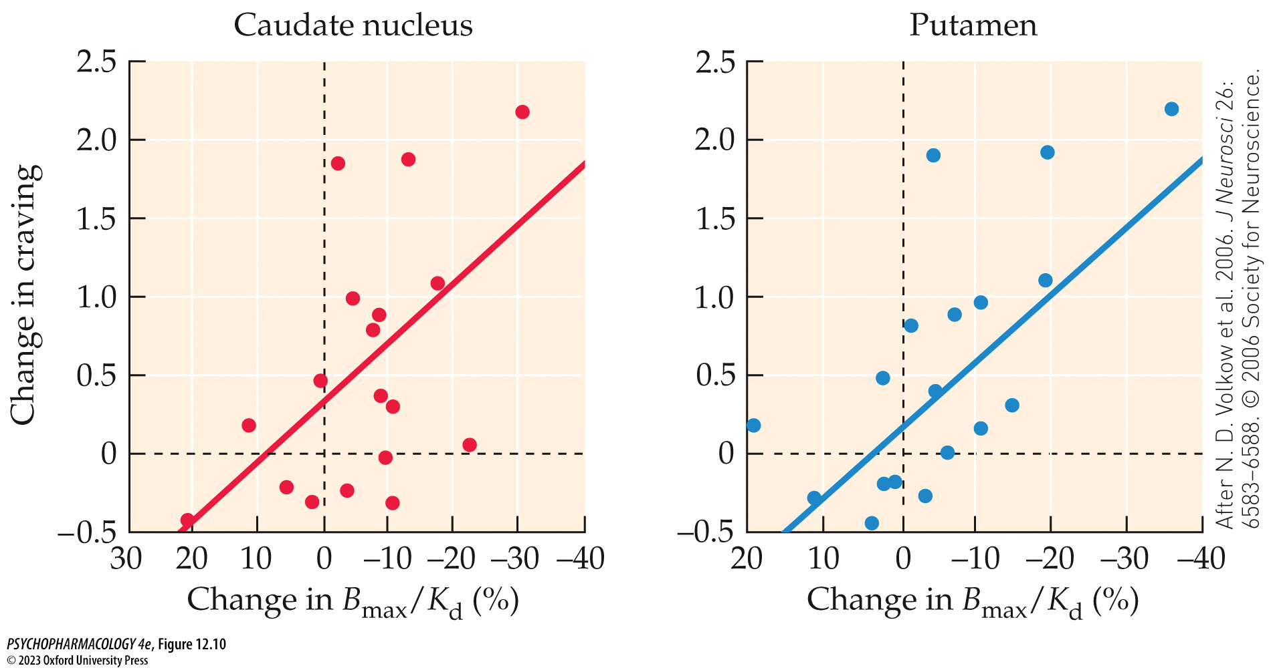
FIGURE 12.10 Relationship between striatal DA release and craving elicited by exposure to cocaine-related visual stimuli
Notes:
FIGURE 12.10 Relationship between striatal DA release and craving elicited by exposure to cocaine-related visual stimuli
Cocaine-addicted individuals were exposed to a video of cocaine-related cues including purchase, preparation, and smoking of the drug while undergoing PET scanning of striatal DA release measured by DA displacement of radiolabeled raclopride from D₂ receptors. The y-axis of the graph plots changes in subjective cocaine craving from before to the end of the video. The x-axis plots changes in DA release measured by alterations in raclopride binding. Significant positive correlations were found for both the caudate nucleus and the putamen, indicating that cue-induced cocaine craving is associated with heightened striatal DA release. (After N. D. Volkow et al. 2006. J Neurosci 26: 6583–6588. © 2006 Society for Neuroscience.)

Slide 31
Cocaine Use and the Effects of Chronic Cocaine Exposure (3 of 10)
Chronic cocaine exposure leads to significant neurobiological and behavioral changes
Brain imaging studies show reduced striatal dopaminergic activity in drug users
The findings demonstrate down-regulation of dopaminergic activity with chronic use of cocaine and other psychostimulants; such down-regulation would be expected to result in tolerance
Notes:
Instructor Notes:

Slide 32
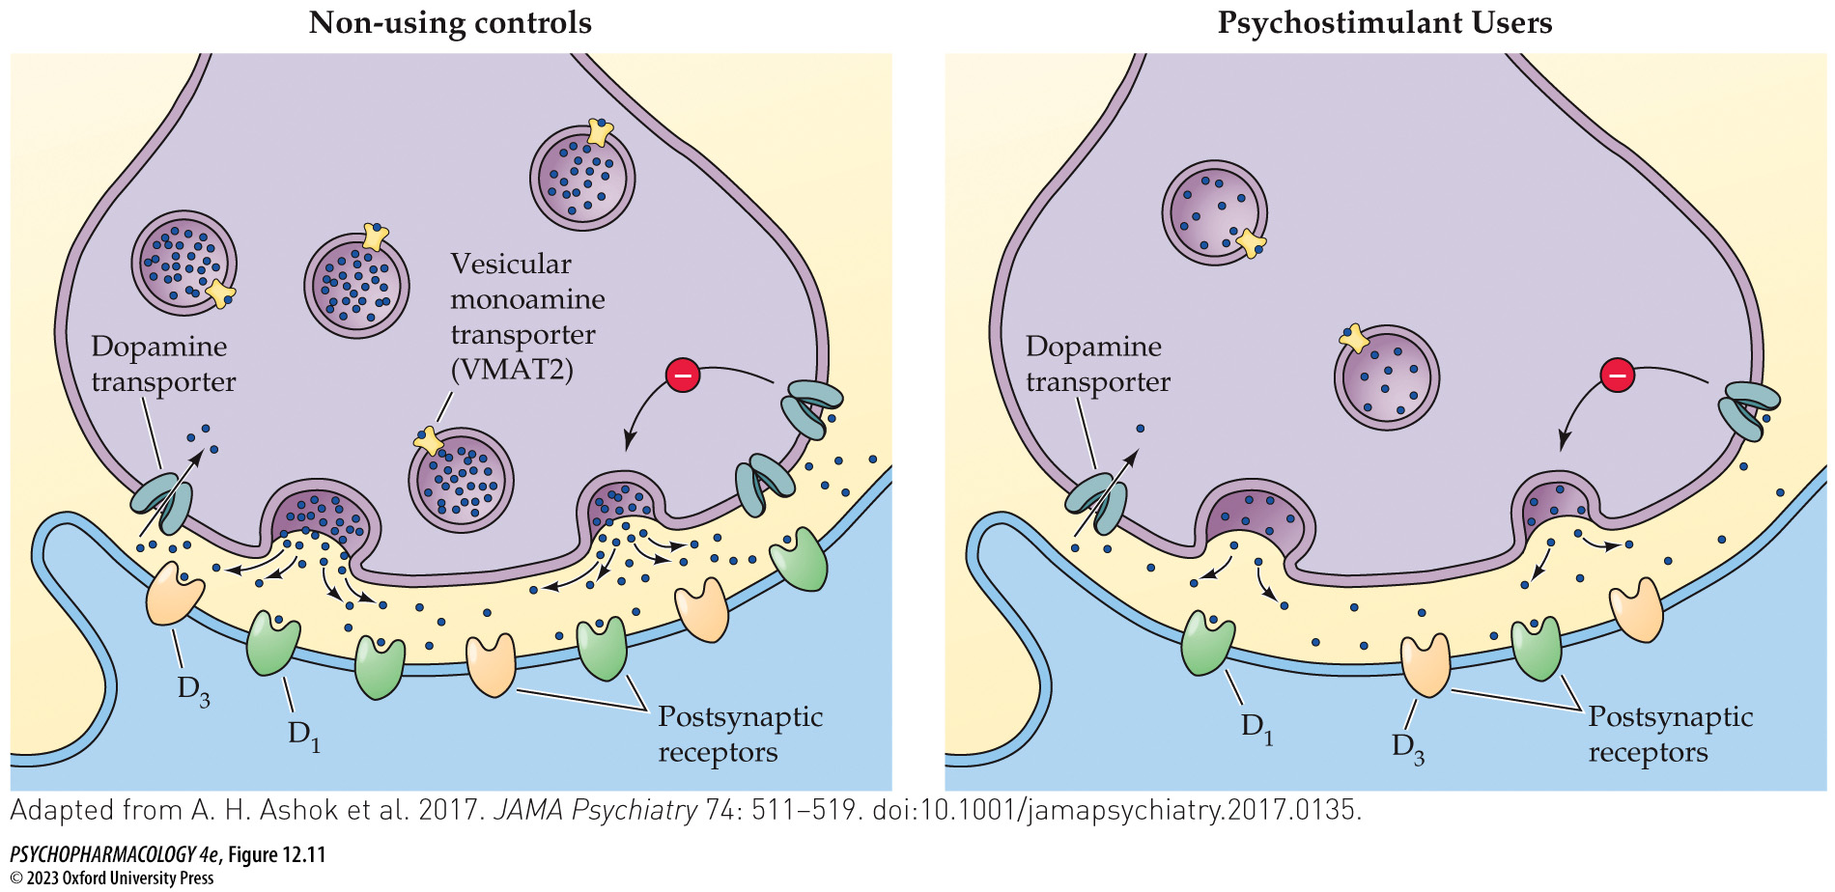
FIGURE 12.11 Summary of altered striatal dopaminergic markers in chronic psychostimulant users compared to non-using controls
Notes:
FIGURE 12.11 Summary of altered striatal dopaminergic markers in chronic psychostimulant users compared to non-using controls
Brain imaging methods such as PET were used to quantify several markers of striatal dopaminergic activity including DA synthesis, DA release, VMAT2 binding, DAT binding, and D₂/D₃ receptor binding. Relative levels of each marker are shown for non-using controls (A) versus chronic psychostimulant (cocaine, amphetamine, or methamphetamine) users (B). The figure illustrates that the psychostimulant users showed decreased DA synthesis (illustrated by fewer DA molecules per synaptic vesicle and fewer vesicles), decreased DA release (illustrated by fewer DA molecules in the synaptic cleft), less DAT binding, and less D₂/D₃ receptor binding. Note that because the drug used to label the DA receptors did not differentiate between D₂ and D₃ receptors, this uncertainty is reflected in a decrease in both receptor subtypes. Not shown are the VMAT2 binding results, which varied depending on the period of abstinence from psychostimulant use. Elevated VMAT2 binding was observed in users who were recently abstinent at the time of the study, whereas decreased binding was found after prolonged drug abstinence. (Adapted from A. H. Ashok et al. 2017. JAMA Psychiatry 74: 511–519. doi:10.1001/jamapsychiatry.2017.0135.)

Slide 33
Cocaine Use and the Effects of Chronic Cocaine Exposure (4 of 10)
Chronic cocaine exposure leads to significant neurobiological and behavioral changes
Psychostimulants can produce both tolerance and sensitization; depends on pattern of drug exposure, response that’s being measured, and time since last dose.
Two phases of sensitization: induction and expression; between the two phases (after last drug dose), sensitization can increase in strength as a result of ongoing neurochemical changes in the brain.
Notes:
Instructor Notes:
Sensitization = reverse tolerance
Induction—the process by which sensitization is established.
Expression—the process by which the sensitized response is manifested

Slide 34
Cocaine Use and the Effects of Chronic Cocaine Exposure (5 of 10)
BOX 12.1 THE CUTTING EDGE
Neurochemical Mechanisms of Cocaine Tolerance and Sensitization
Long-access self-administering rats (constant high brain cocaine levels) show molecular adaptations in NAcc dopaminergic nerves and behavioral tolerance
Intermittent access self-administration (repeated spikes in brain cocaine) leads to increased potency of cocaine to inhibit DA uptake and behavioral sensitization
There is also evidence for rapid sensitization of the mesolimbic DA pathway produced by a single drug exposure
Notes:
Instructor Notes:

Slide 35
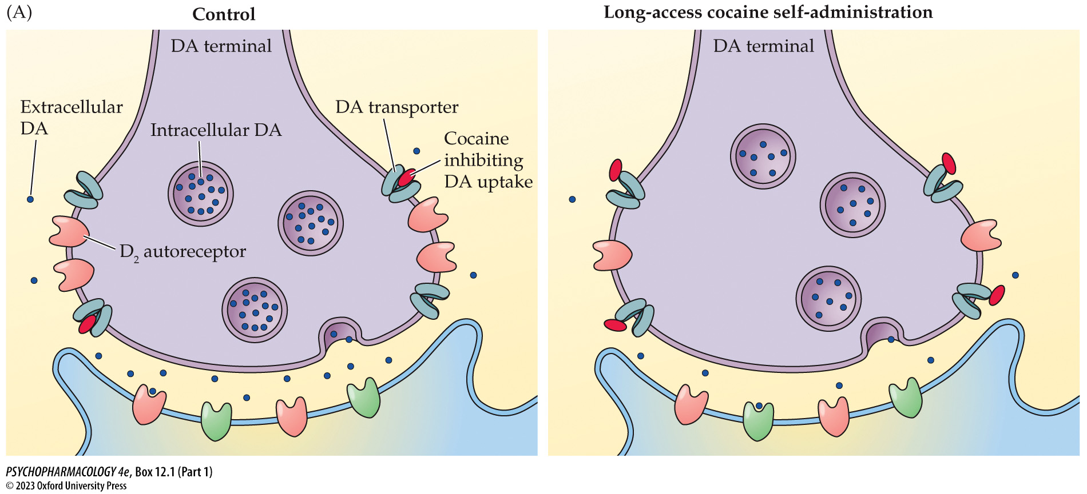
Box 12.1 The Cutting Edge: Neurochemical Mechanisms of Cocaine Tolerance and Sensitization (Part 1)
Notes:
Box 12.1 The Cutting Edge: Neurochemical Mechanisms of Cocaine Tolerance and Sensitization
FIGURE A Molecular adaptations in the nucleus accumbens underlying tolerance due to long-access cocaine self-administration
(After C. A. Siciliano et al. 2015. Chem Neurosci 6: 27–36. http://pubs.acs.org/doi/10.1021/cn5002705. Further permissions related to the material excerpted should be directed to the ACS.)

Slide 36
Cocaine Use and the Effects of Chronic Cocaine Exposure (6 of 10)
Chronic cocaine exposure leads to significant neurobiological and behavioral changes
Individuals with cocaine use disorder show deficits in many cognitive domains; but this is disputed by some researchers
Brain imaging shows differences in many brain areas between users and non-users
One study: loss of gray matter with increasing age was much greater in the cocaine-dependent group
Notes:
Instructor Notes:

Slide 37
Cocaine Use and the Effects of Chronic Cocaine Exposure (7 of 10)
Repeated or high-dose cocaine use can produce serious health consequences
Stroke, seizures, panic attacks, and temporary paranoid psychosis with delusions and hallucinations
Other organ systems such as cardiovascular, lungs, kidneys, and GI system can be adversely affected
Frequent snorting can cause perforation of the nasal septum
Cocaine use during pregnancy can result in attention deficits or other behavioral or cognitive abnormalities in the child
Notes:
Instructor Notes:

Slide 38
Cocaine Use and the Effects of Chronic Cocaine Exposure (8 of 10)
Pharmacological, behavioral, and psychosocial methods are used to treat cocaine use disorder
Many compounds have been tested as potential medications, but none have been approved for cocaine use disorder
Potential options: full or partial DA agonists and psycho-stimulants such as amphetamine, as potential replacement drugs
Vaccines: antibodies to bind cocaine molecules, or they may be engineered to break down cocaine in the bloodstream
Notes:
Instructor Notes:

Slide 39
Cocaine Use and the Effects of Chronic Cocaine Exposure (9 of 10)
Pharmacological, behavioral, and psychosocial methods are used to treat cocaine use disorder
Psychosocial treatment programs involve individual, group, or family counseling
Cognitive behavioral therapy (CBT) aimed at restructuring cognitive processes and training
12-step programs: Narcotics Anonymous, Cocaine Anonymous
Contingency management programs
Notes:
Instructor Notes:
CBT is also called relapse prevention therapy

Slide 40
Cocaine Use and the Effects of Chronic Cocaine Exposure (10 of 10)
Pharmacological, behavioral, and psychosocial methods are used to treat cocaine use disorder
Brain stimulation to alter the brain circuitry underlying drug craving, impulsive drug seeking, etc.
  Repetitive transcranial magnetic stimulation (rTMS)
  Transcranial direct current stimulation (tDCS)
  Deep brain stimulation (DBS)
Notes:
Instructor Notes:

Slide 41
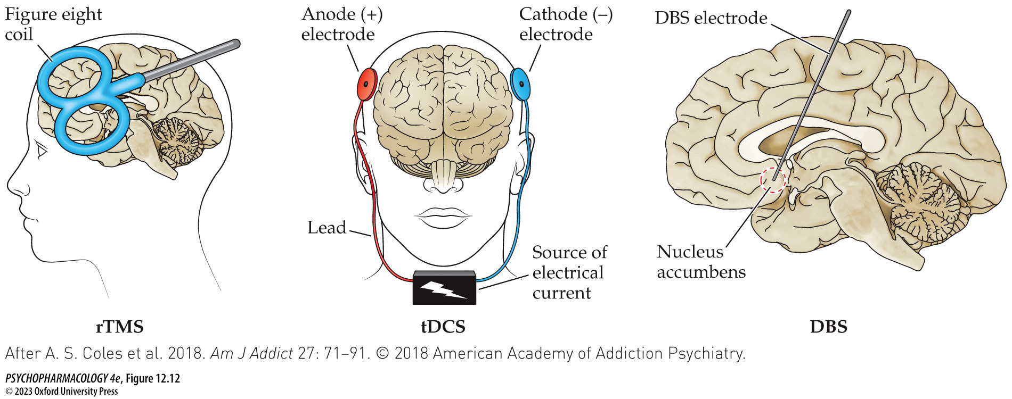
FIGURE 12.12 Brain stimulation methods being tested for the treatment of substance use disorders
Notes:
FIGURE 12.12 Brain stimulation methods being tested for the treatment of substance use disorders
The brain stimulation methods illustrated are being tested for the treatment of substance use disorders, including cocaine use disorder. The methods are repetitive transcranial magnetic stimulation (rTMS), transcranial direct current stimulation (tDCS), and deep brain stimulation (DBS). (After A. S. Coles et al. 2018. Am J Addict 27: 71–91. © 2018 American Academy of Addiction Psychiatry.)

Slide 42
Review of Learning Objectives (3 of 7)
12.3.1 Describe the identified patterns of cocaine use, the characteristics of cocaine binges, and the development of cocaine use disorder.
12.3.2 Discuss the neurobiological and behavioral changes caused by chronic cocaine exposure.
12.3.3 List the major health consequences that can occur as a result of repeated and/or high-dose cocaine use.
12.3.4 Describe the various therapeutic approaches available to treat cocaine use disorder.

Slide 43
Background, History, and Basic Pharmacology of the Amphetamines (1 of 3)
Background and history
Amphetamines: synthetic; structurally related to DA
  L-amphetamine (Benzedrine)
  D-amphetamine (dextroamphetamine; Dexedrine).
  Methamphetamine – synthesized from pseudoephedrine
Plant compounds:
  Cathinone – active ingredient in khat; from a shrub
  Ephedrine – from the herb Ephedra; sold for weight loss but has dangerous side effects
Notes:
Instructor Notes:

Slide 44
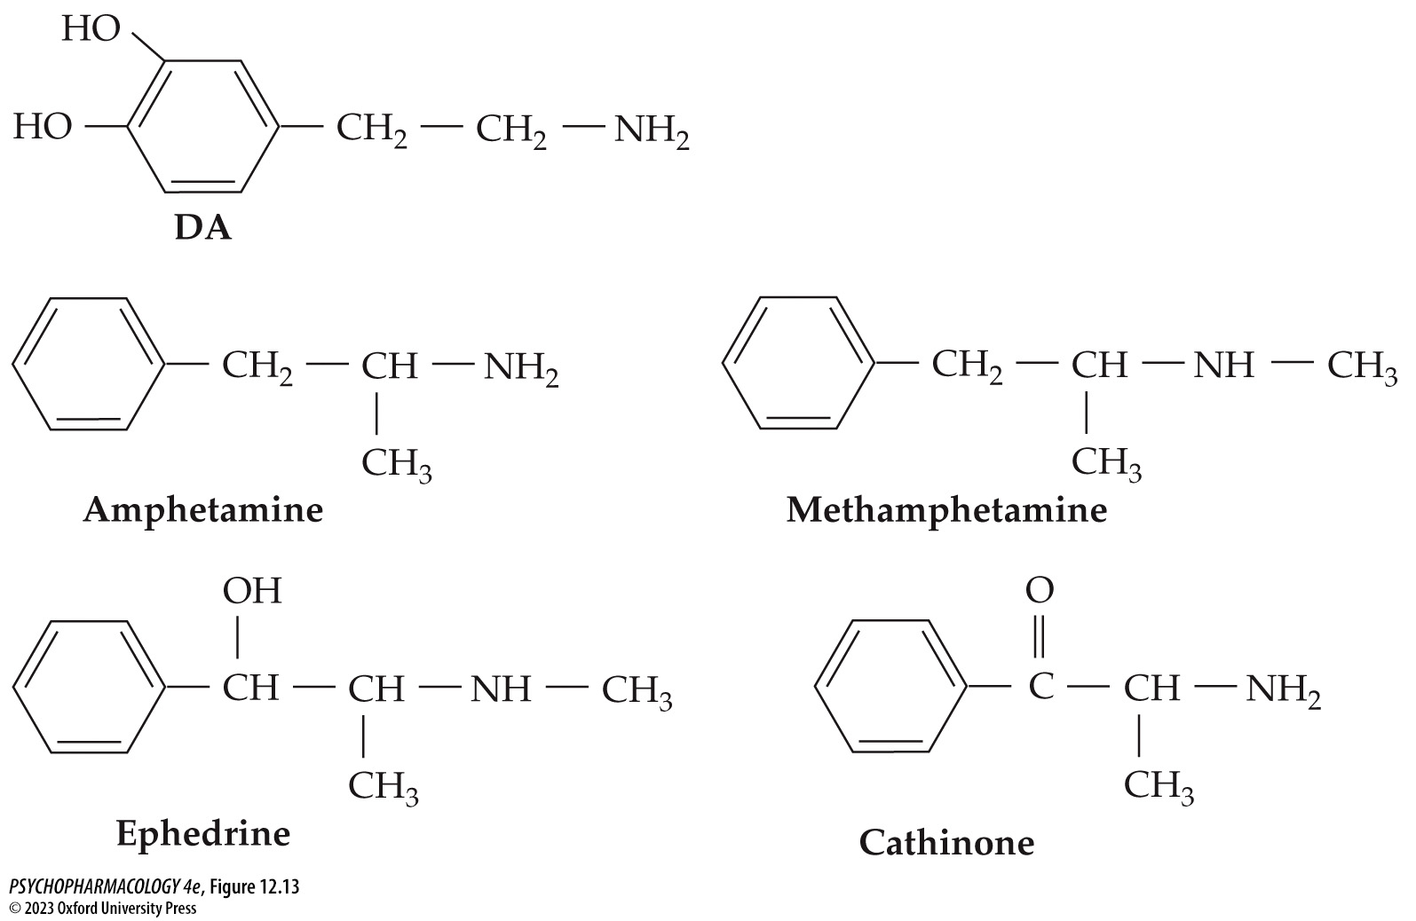
FIGURE 12.13 Amphetamine and related psychostimulants resemble the neurotransmitter DA in their chemical structure
Notes:
FIGURE 12.13 Amphetamine and related psychostimulants resemble the neurotransmitter DA in their chemical structure
This accounts for their potent effects on the dopaminergic system.

Slide 45
Background, History, and Basic Pharmacology of the Amphetamines (2 of 3)
Basic pharmacology
Amphetamine is typically taken orally or IV or subcutaneous injection (skin popping)
Absorption from GI tract is slow; IV injection provides a rapid and intense “high;” has much greater addictive potential.
Methamphetamine is more potent; can be taken orally, snorted, injected intravenously, or smoked
Methamphetamine hydrochloride in a crystalline form suitable for smoking is called “ice” or “crystal;” highly addictive
Notes:
Instructor Notes:
Street names for amphetamine include “uppers,” “bennies,” “dexies,” “black beauties,” and “diet pills.”
Street names for methamphetamine are “meth,” “speed,” “crank,” “zip,” and “go.”

Slide 46
Background, History, and Basic Pharmacology of the Amphetamines (3 of 3)
Basic pharmacology
Some users go on binges or runs – repeated injections every 2 hours for 3 to 6 days, with little sleep or eating
Amphetamine and methamphetamine are metabolized slowly by the liver; metabolites are excreted in the urine
Because of long half-lives, users obtain a much longer-lasting high from a single dose of amphetamine or methamphetamine than from a dose of cocaine.
Notes:
Instructor Notes:

Slide 47
Review of Learning Objectives (4 of 7)
12.4.1 Discuss the history and uses (medical and recreational) of the family of psychostimulants that includes amphetamine, methamphetamine, cathinone, and ephedrine.
12.4.2 Describe the basic pharmacology of amphetamine and methamphetamine.

Slide 48
Mechanisms of Action and
Neurobehavioral Effects of Amphetamines (1 of 7)
Mechanisms of amphetamine and methamphetamine action
Amphetamines are indirect catecholamine agonists; stimulate DA and NE release and block reuptake
Stimulate massive DA release by two means:
  Enters nerve terminal by DAT; stimulates DA release from vesicles
  Alters DAT to act in reverse direction to release DA into synapse
NE release also affects sympathetic nervous system
Notes:
Instructor Notes:
High doses can also inhibit catecholamine metabolism by monoamine oxidase.
Reversal of DA transport is mediated by DAT phosphorylation by the protein kinases calcium/calmodulin kinase II (CaMKII) and protein kinase C (PKC).

Slide 49
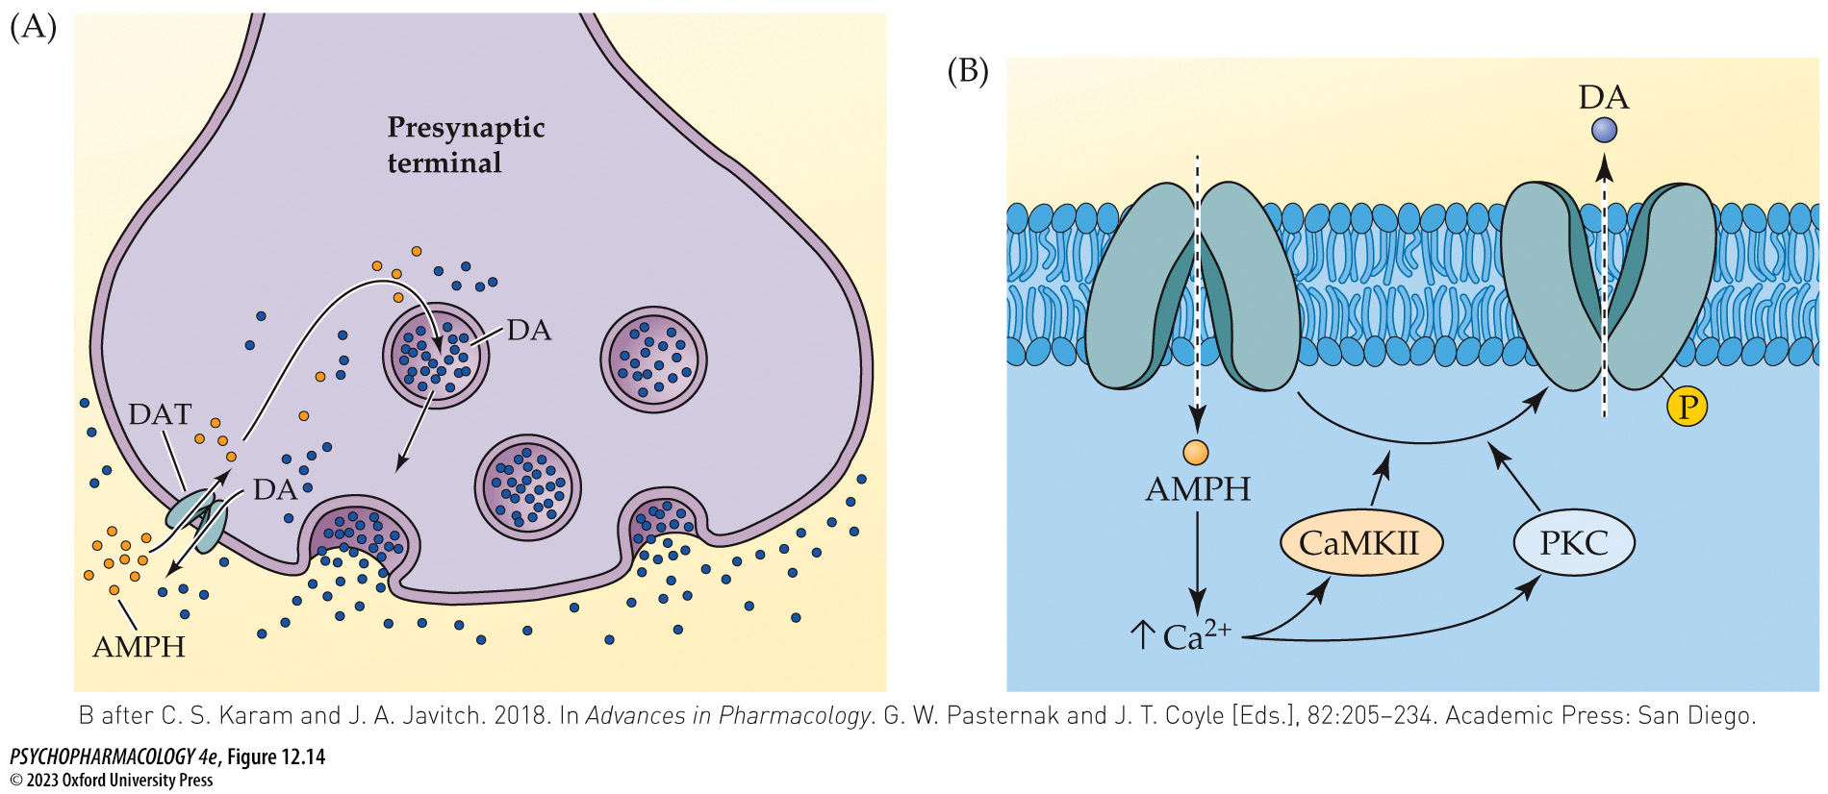
FIGURE 12.14 Mechanisms of amphetamine-stimulated DA release
Notes:
FIGURE 12.14 Mechanisms of amphetamine-stimulated DA release
(A) Amphetamine (AMPH) molecules enter DA nerve terminals in part through uptake by the dopamine transporter (DAT). Once inside the terminal, the drug provokes DA release from the synaptic vesicles into the cytoplasm. (B) Amphetamine additionally alters DAT function so that the transporter acts in a reverse direction to release DA from the cytoplasm into the extracellular fluid. Reversal of DA transport is mediated by DAT phosphorylation by the protein kinases calcium/calmodulin kinase II (CaMKII) and protein kinase C (PKC). Acting together, the processes of vesicular DA release and DAT reversal result in a massive increase in synaptic DA levels. (B after C. S. Karam and J. A. Javitch. 2018. In Advances in Pharmacology. G. W. Pasternak and J. T. Coyle [Eds.], 82: 205–234. Academic Press: San Diego.)

Slide 50
Mechanisms of Action and
Neurobehavioral Effects of Amphetamines (2 of 7)
Neurobehavioral effects of amphetamines
Amphetamines cause heightened alertness, increased confidence, feelings of exhilaration, reduced fatigue, and generalized sense of well-being
Reduced sleep time, especially REM sleep; permits sustained physical effort without rest or sleep
Can enhance athletic performance; banned in competitions
Notes:
Instructor Notes:

Slide 51
Mechanisms of Action and
Neurobehavioral Effects of Amphetamines (3 of 7)
Amphetamine and methamphetamine have therapeutic uses
Narcolepsy: recurring and irresistible attacks of sleepiness during daytime hours, cataplexy, hypnagogic hallucinations, sleep paralysis
Treatment of ADHD
Appetite suppressant and antiobesity treatment; because of high abuse potential, is it now rarely used
Notes:
Instructor Notes:

Slide 52
Mechanisms of Action and
Neurobehavioral Effects of Amphetamines (4 of 7)
High doses or chronic use of amphetamines can cause a variety of adverse effects
Heavy methamphetamine use leads to dependence
Withdrawal syndrome less severe than with opioids or alcohol; negative reinforcement has less impact
Methamphetamine users show impairments in multiple cognitive domains - impulse control, verbal learning, working memory, and social cognition
Women are more likely than men to become dependent
Notes:
Instructor Notes:

Slide 53
Mechanisms of Action and
Neurobehavioral Effects of Amphetamines (5 of 7)
High doses or chronic use of amphetamines can cause a variety of adverse effects
As methamphetamine use has increased, incidence of psychotic reactions has also grown, especially if there are pre-existing psychotic symptoms
Continued methamphetamine use can cause a transition to a psychotic state that persists long after abstinence, similar to schizophrenia
Neurotoxicity: damage or death of DA system neurons
Notes:
Instructor Notes:

Slide 54
Mechanisms of Action and
Neurobehavioral Effects of Amphetamines (6 of 7)
High doses or chronic use of amphetamines can cause a variety of adverse effects
Hard-core methamphetamine users have increased risk of Parkinson’s disease, cardiovascular disease, gastrointestinal distress, increased susceptibility to infection, male sexual dysfunction, and oral diseases
Chronic users show premature aging and increased mortality rate
Notes:
Instructor Notes:

Slide 55
Mechanisms of Action and
Neurobehavioral Effects of Amphetamines (7 of 7)
CLICKER QUESTION 2
Reversing dopamine transporter function is a mechanism of which drug?
Amphetamines
Cocaine
Cathinones
Methyphenidate
Notes:
Instructor Notes:
Correct answer: a

Slide 56
Review of Learning Objectives (5 of 7)
12.5.1 Explain the mechanisms of action of amphetamines on the dopaminergic system.
12.5.2 Contrast the therapeutic uses of amphetamines with their illicit use.
12.5.3 Discuss the features of methamphetamine misuse, including (a) dependence and withdrawal and (b) impaired cognitive function.
12.5.4 Describe evidence showing that high-dose methamphetamine use causes psychotic reactions, neurotoxicity, and other health problems.

Slide 57
Methylphenidate and Modafinil (1 of 4)
Methylphenidate (Ritalin)
Activates catecholamine transmission by blocking DAT and NET - increases extracellular levels of DA and NE
Effects include increased arousal, alertness, ability to concentrate; elevated mood; low to medium doses have a positive influence on cognitive functions
Oral methyphenidate has little risk of misuse but tablets can be crushed for snorting or IV injection – could lead to dependence
A possible therapeutic application is to accelerate emergence from general anesthesia
Notes:
Instructor Notes:

Slide 58
Methylphenidate and Modafinil (2 of 4)
BOX 12.2 CLINICAL APPLICATIONS
Psychostimulants and ADHD
Major use of methylphenidate is treatment of ADHD: characterized by extreme inattentiveness, impulsivity, and hyperkinesis; thought to be related to dysfunction in complex neural circuits that include the PFC
Psychostimulants have a seemingly paradoxical calming effect
Other pharmacological treatments include various amphetamine formulations, the NE reuptake inhibitor atomoxetine, and α_{2A}-receptor agonists.
Notes:
Instructor Notes:
ADHD: attention-deficit/hyperactivity disorder

Slide 59
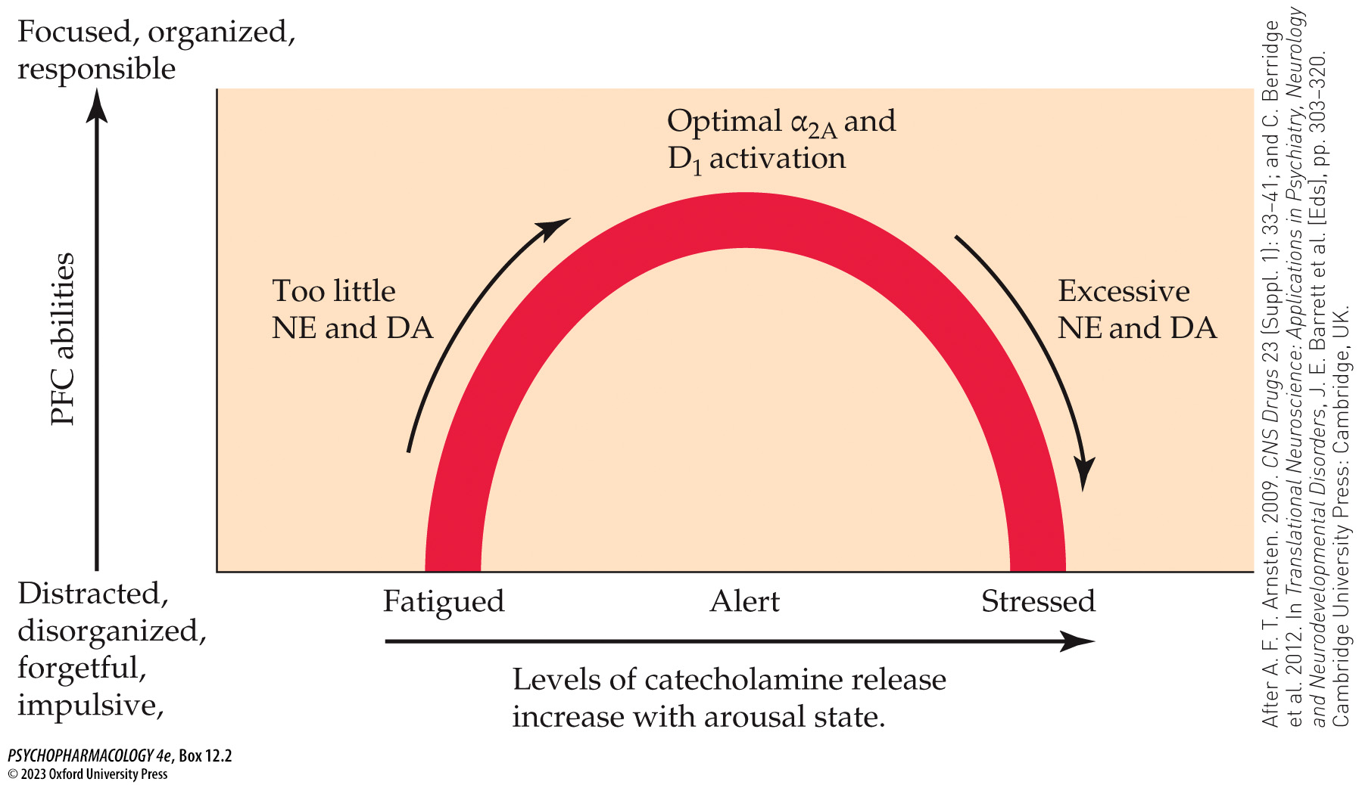
Box 12.2 Clinical Applications: Psychostimulants and ADHD
Notes:
Box 12.2 Clinical Applications: Psychostimulants and ADHD
Hypothesized role of prefrontal cortical α_{2A} and D₁ receptors in cognitive performance and the treatment of ADHD
Activation of α_{2A} and D₁ receptors in the PFC is thought to depend on the organism’s state of arousal. A moderate level of arousal leads to intermediate levels of receptor activation that are optimal for PFC functioning, whereas either too little or too much activation has detrimental effects on PFC functioning and cognitive performance. (After A. F. T. Arnsten. 2009. CNS Drugs 23 (Suppl. 1): 33–41; and C. Berridge et al. 2012. In Translational Neuroscience: Applications in Psychiatry, Neurology and Neurodevelopmental Disorders, J. E. Barrett et al. [Eds], pp. 303–320. Cambridge University Press: Cambridge, UK.)

Slide 60
Methylphenidate and Modafinil (3 of 4)
Modafinil (Provigil)
Modafinil binds to DAT with low affinity and acts as a weak DA uptake inhibitor
Also stimulates release of NE and orexin, integral components of the brain’s arousal system and inhibits GABA release.
Approved for treatment of narcolepsy, obstructive sleep apnea, and individuals with disordered sleep due to shift work.
Notes:
Instructor Notes:

Slide 61
Methylphenidate and Modafinil (4 of 4)
CLICKER QUESTION 3
Methyphenidate is most commonly used to treat
Parkinson’s disease.
cocaine use disorder.
narcolepsy.
ADHD.
Notes:
Instructor Notes:
Correct answer: a

Slide 62
Review of Learning Objectives (6 of 7)
12.6.1 Discuss the pharmacology of methylphenidate.
12.6.2 Describe the features of ADHD, including symptoms, proposed dysfunction of the PFC catecholamine symptoms, and the mechanisms of action of drugs (including psychostimulants) used to treat this disorder.
12.6.3 Discuss the pharmacology of modafinil and its therapeutic use in the treatment of narcolepsy.

Slide 63
Synthetic Cathinones
Many derivatives have been identified; four have been studied: mephedrone, methylone, MDPV, α-PVP
Recent surge in recreational use, under many street names; acute effects are similar to other psychostimulants
Mephedrone and methylone are similar to amphetamine: they are substrates for DAT, NET, and SERT – cause acute release of DA, NE, and 5-HT.
MDPV and α-PVP are selective reuptake inhibitors of DA and NE; similar to the action of methylphenidate.
Animal studies have shown that synthetic cathinones are highly rewarding and reinforcing
Notes:
Instructor Notes:
mephedrone (4-methylmethcathinone),
methylone (3,4-methylenedioxy-N-methylcathinone),
MDPV (3,4-methylenedioxypyrovalerone)
α-PVP (α-pyrrolidinovalerophenone)

Slide 64
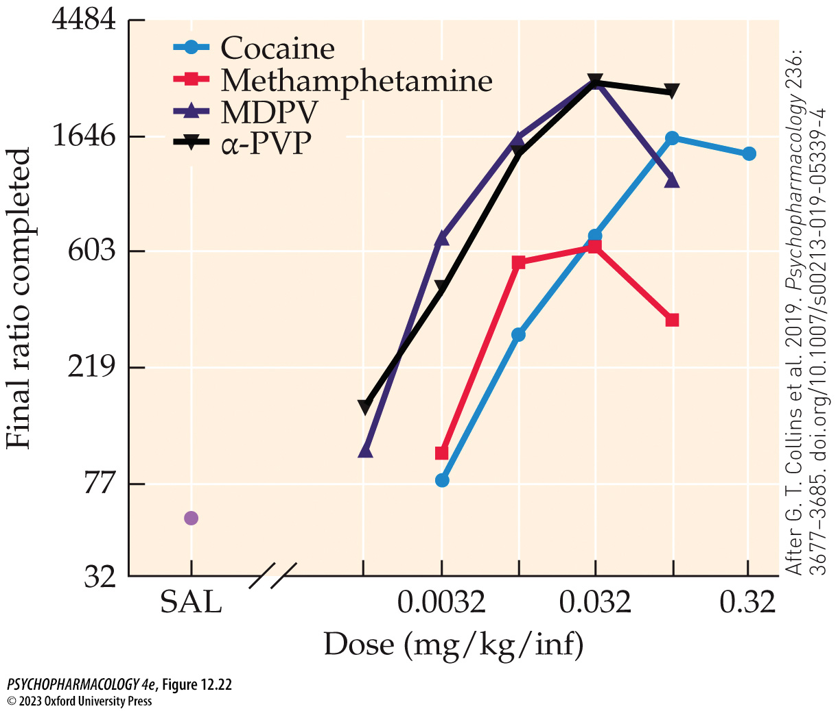
FIGURE 12.22 Dose-dependent IV self-administration of MDPV, α-PVP, cocaine, and methamphetamine in rhesus monkeys
Notes:
FIGURE 12.22 Dose-dependent IV self-administration of MDPV, α-PVP, cocaine, and methamphetamine in rhesus monkeys
Four monkeys were trained to self-administer the listed drugs intravenously and were then tested on a progressive ratio (PR) schedule to determine the reinforcing effectiveness (E_{max}) of each compound based on the highest completed response ratio, similar to the breakpoint discussed earlier in the chapter. The graph illustrates the mean number of completed ratios for each drug at the indicated dose (dose = mg/kg per infusion). At low to moderate doses, both synthetic cathinones yielded a higher E_{max} than either cocaine or methamphetamine, indicative of greater reinforcing value at those doses. The highest drug doses showed either a flattening or a downward inflection of the dose–response function, which may be related to the onset of aversive drug effects at those doses (see King and Riley, 2017). SAL shows the mean number of responses for saline vehicle instead of drug. (After G. T. Collins et al. 2019. Psychopharmacology 236: 3677–3685. doi.org/10.1007/s00213-019-05339-4)

Slide 65
Review of Learning Objectives (7 of 7)
12.7.1 Name the four synthetic cathinones that have been studied most extensively, and describe their introduction as “street drugs.”
12.7.2 Discuss the basic pharmacology of synthetic cathinones, including routes of administration, subjective effects, and mechanisms of action.
12.7.3 Describe the evidence for potential neurotoxic effects of synthetic cathinones.

